Slide 1
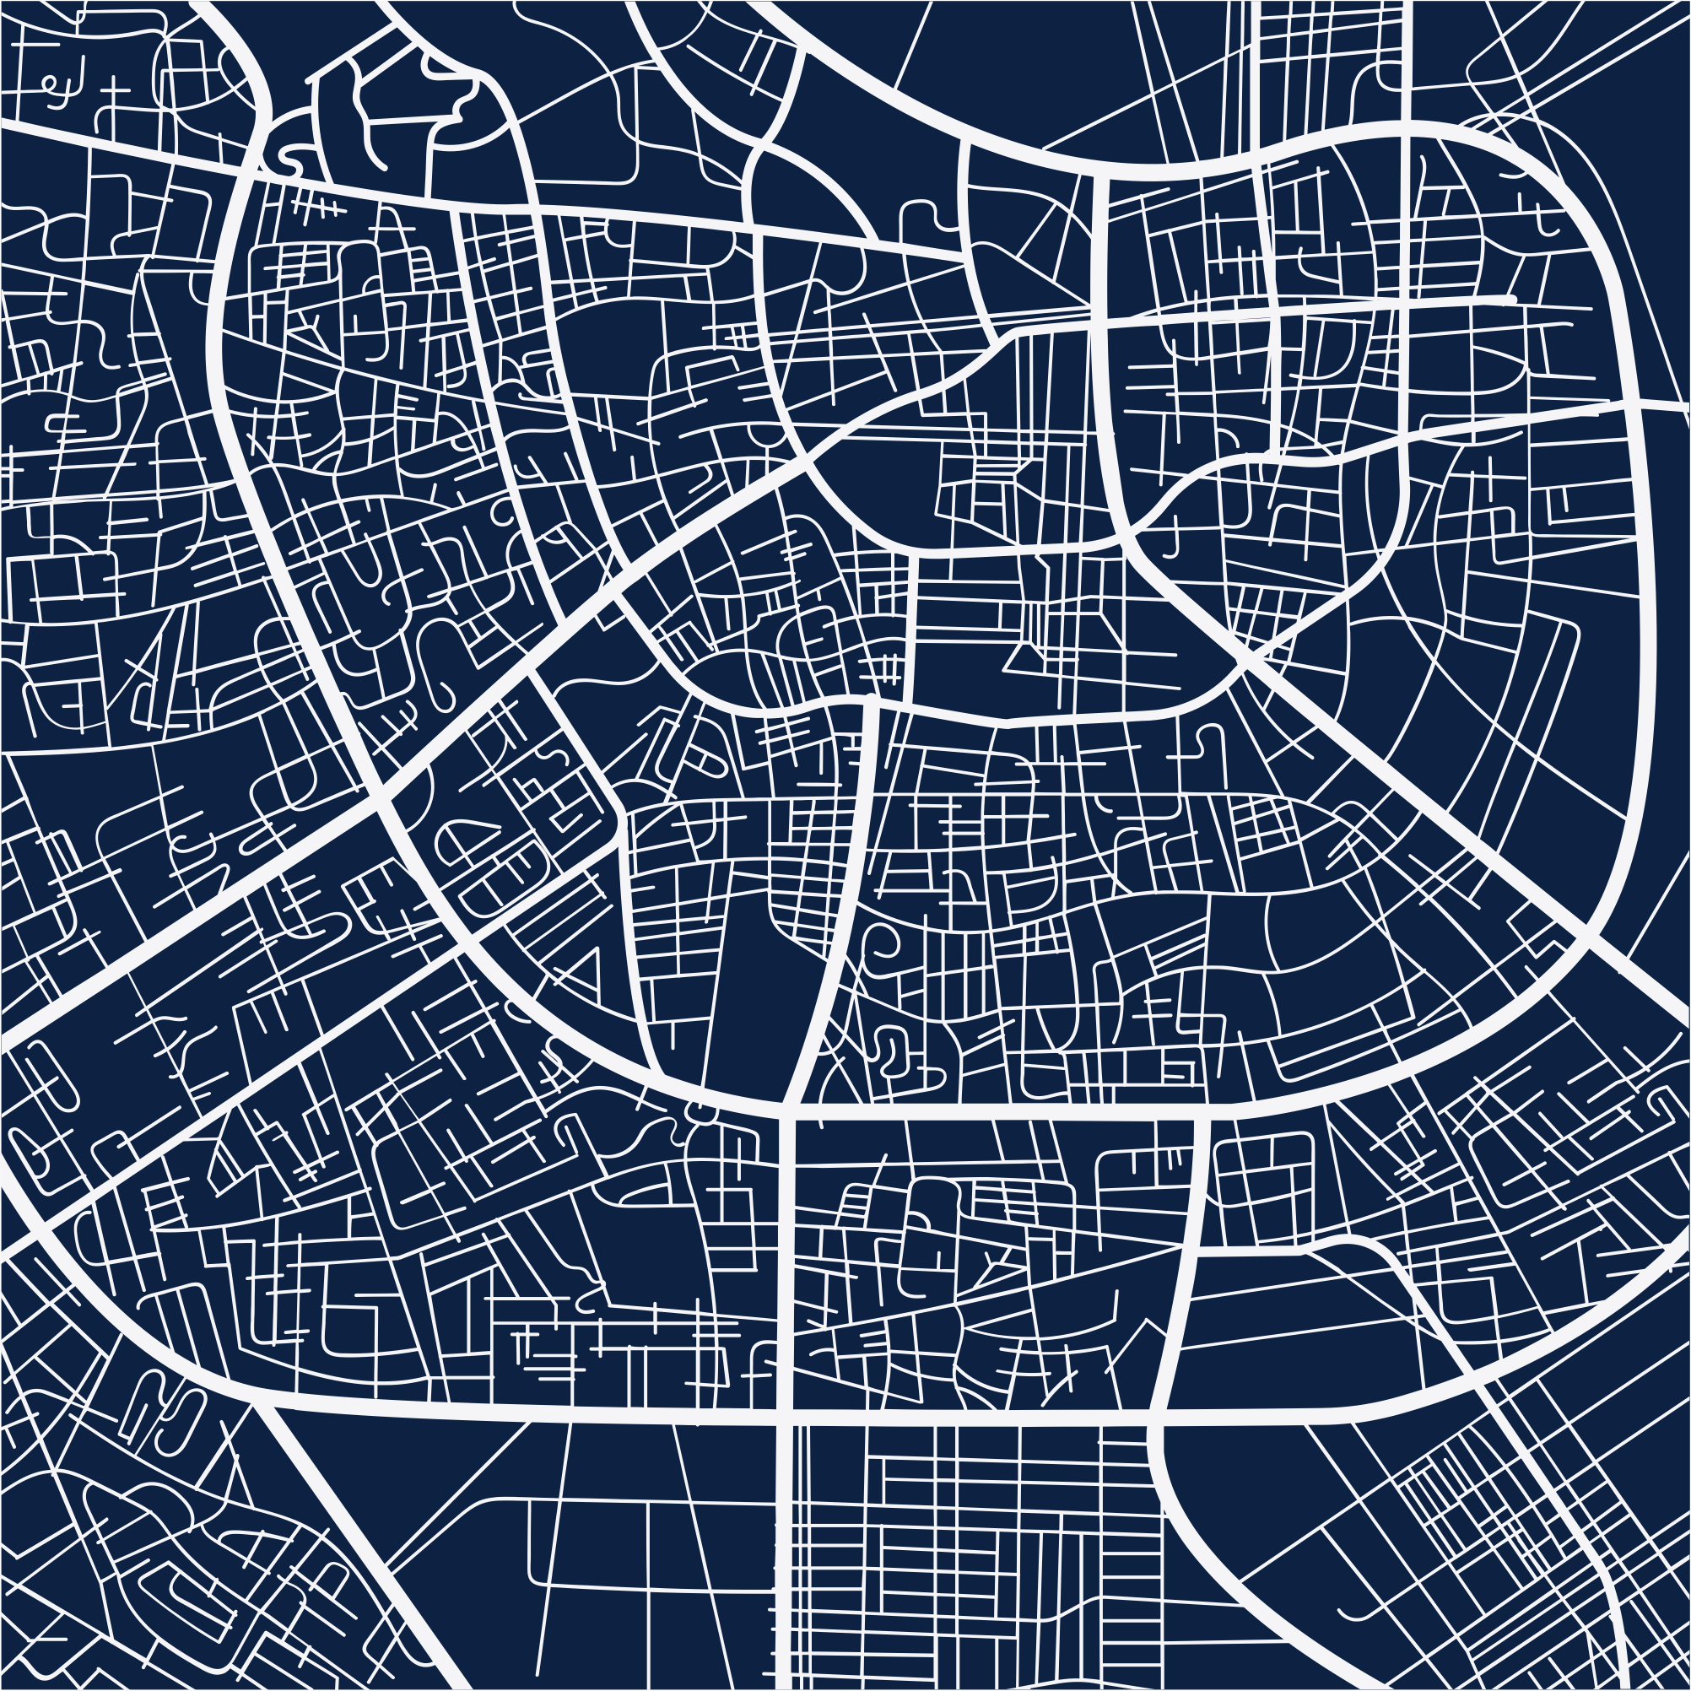

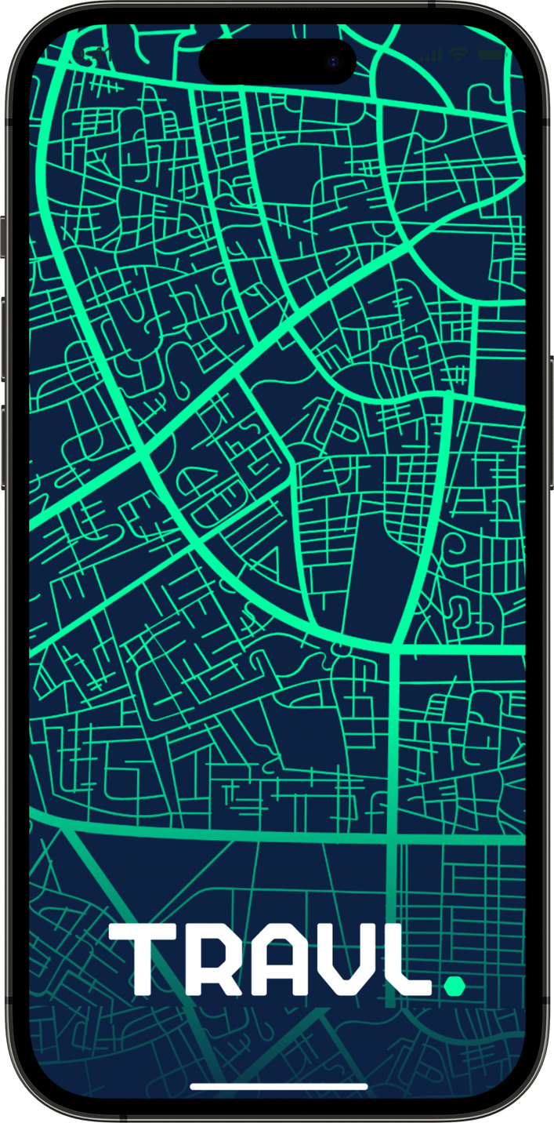
Travel and tourism system
Presented by:
Rawan Mohamed
Ali Mahmoud
Fouad Hossam
Omar Rayyan
Fares Hussein

Slide 2
The System consist from:
Itinerary Planning
Booking Management
Attraction Management

Slide 3
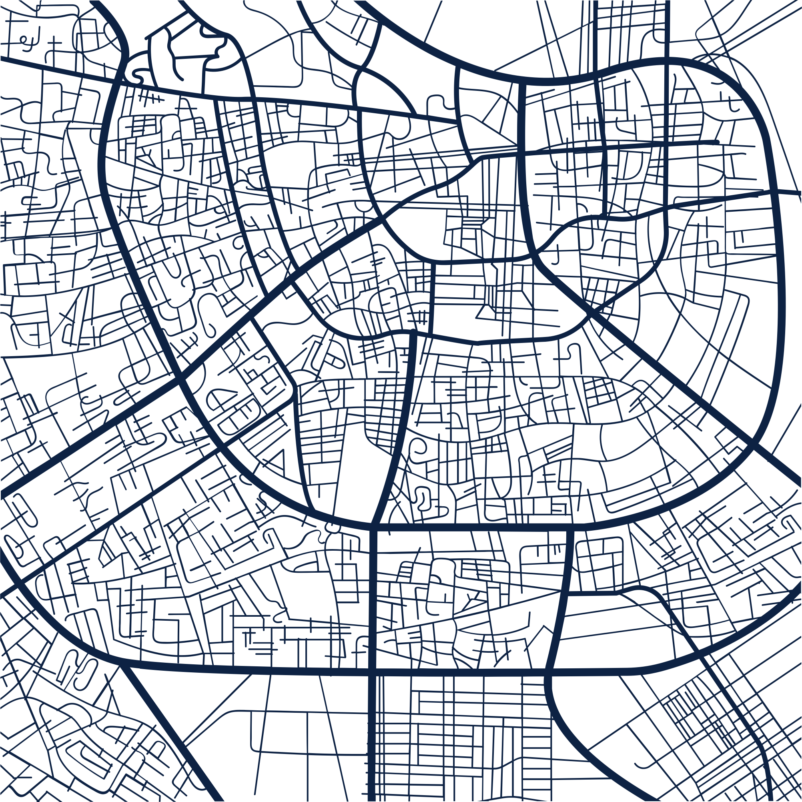
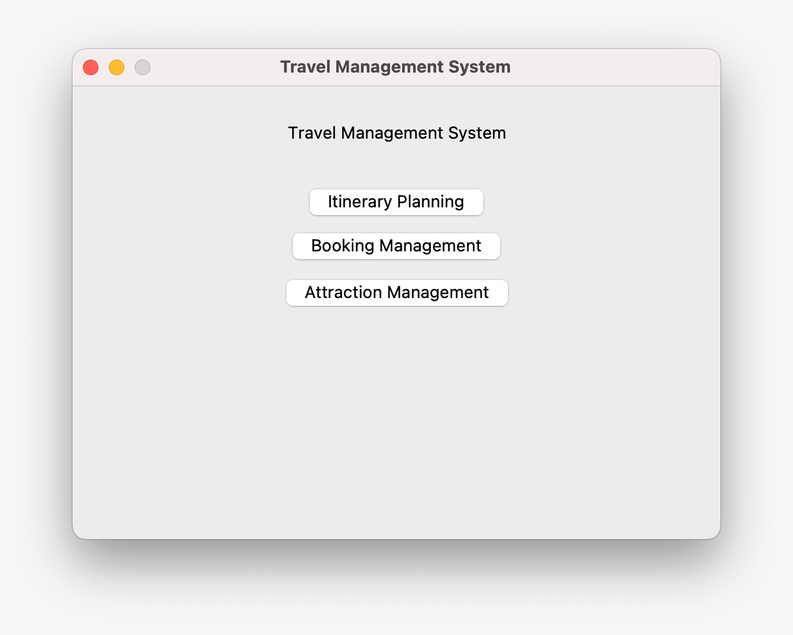

Slide 4
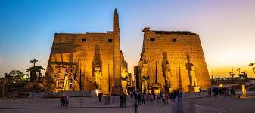
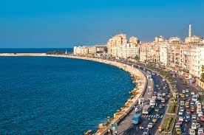
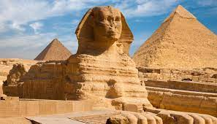
Technical Uses:
Database to store the Data (SQLite3)
Data structures techniques:
1.Graphs
2.Queues
3.Arrays
4. Pathfinding Algorithms
5. Sorting and Searching Algorithms

Slide 5
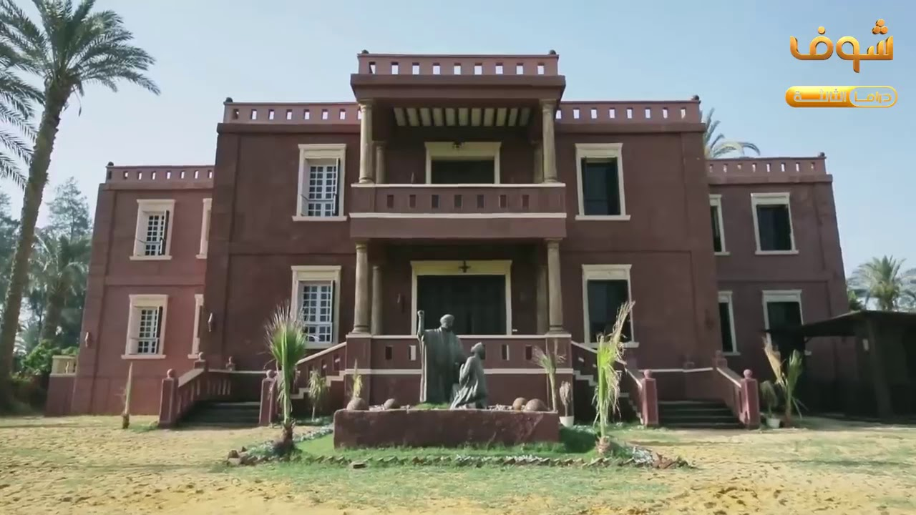
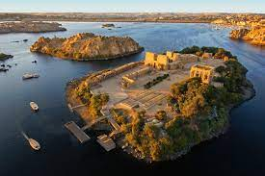
Technical Uses:
Important Libraries :
Pandas
Threading
Time
Sqlite3
OS
UI
Thinker
Numpy
Heapq
PIL

Slide 6

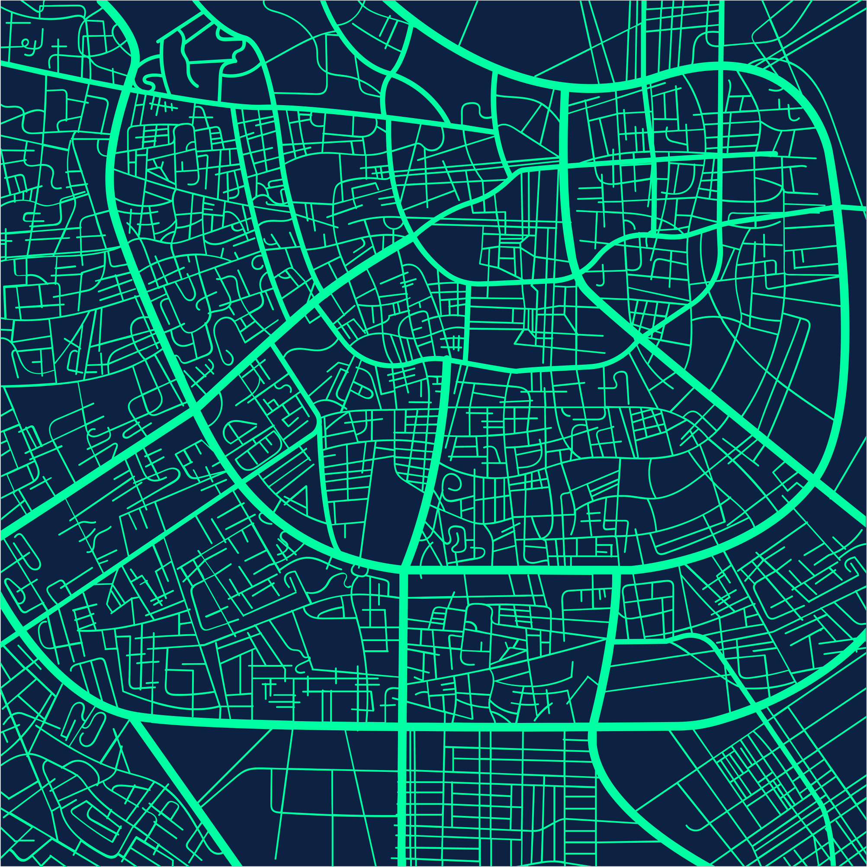
Itinerary Planning

Slide 7
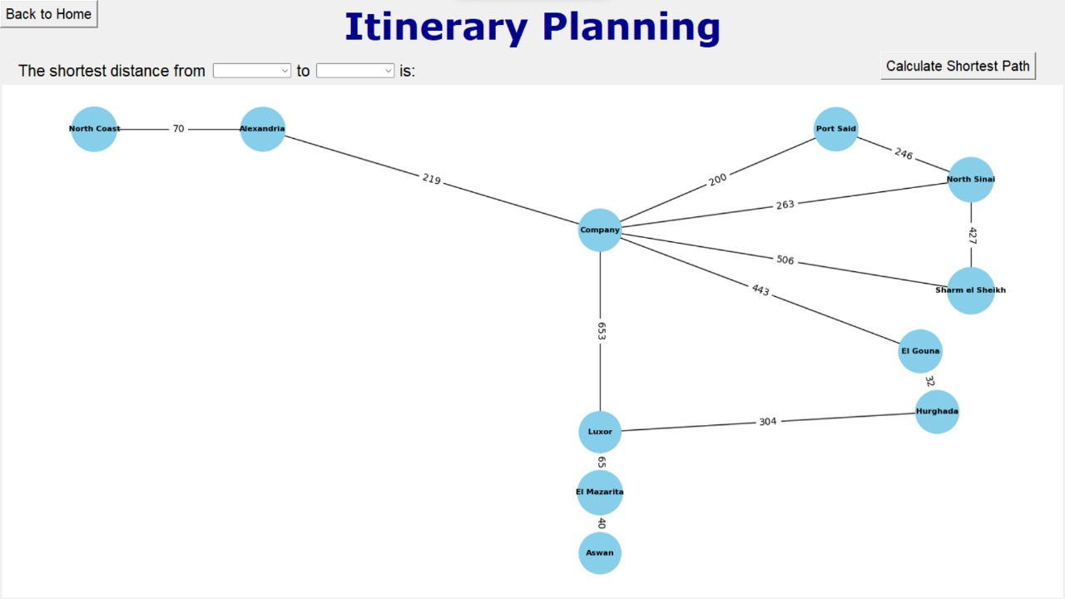
IT display the map of destinations

Slide 8
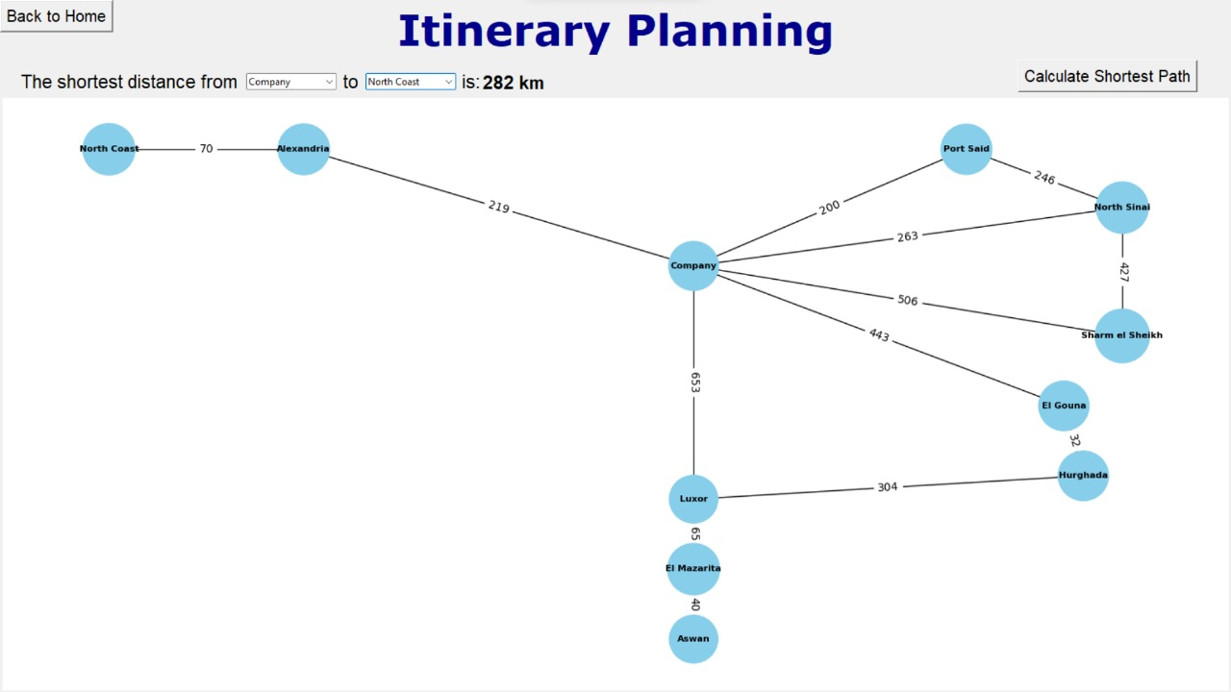
travl
•
As demonstrated, selecting two destinations will provide the shortest distance between the chosen cities.
In this example, specifically from the company to the North Coast, the calculated shortest distance is 282 kilometers.

Slide 9
Booking management

Slide 10
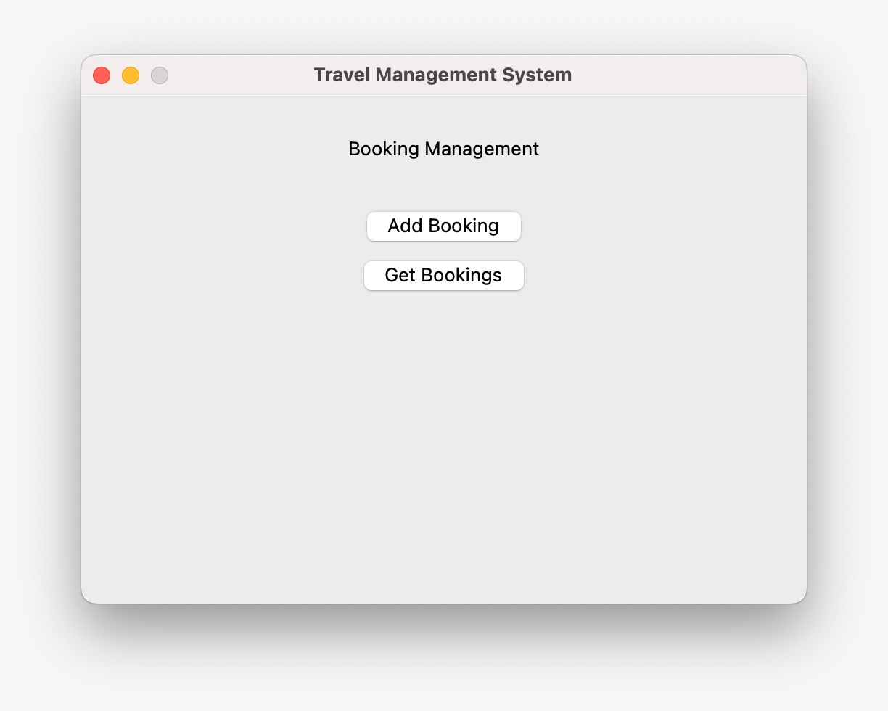
travl
•
The primary components of booking management encompass the following options:
Addition of Booking
Retrieval of Bookings
The user selects the desired action based on their specific requirements.

Slide 11
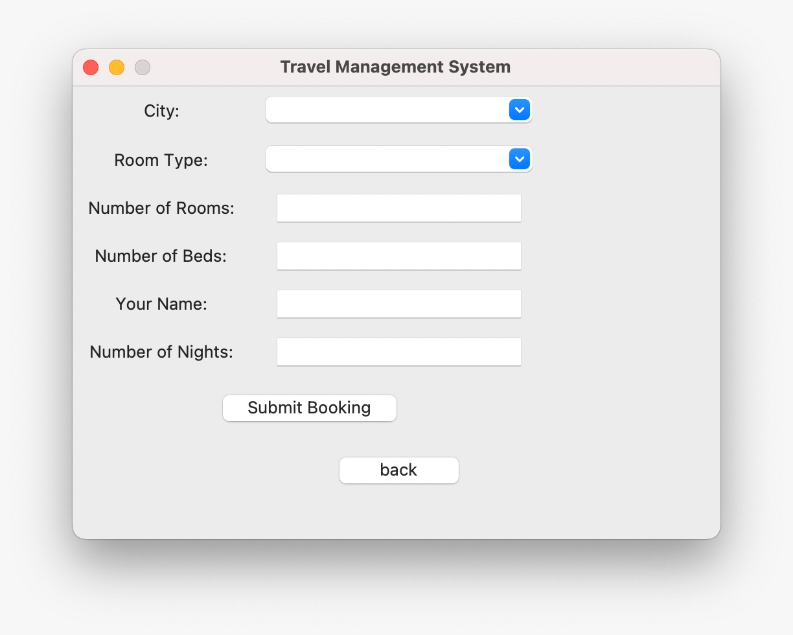
Add Booking
As demonstrated, users input their preferences, and subsequently.
The system provides optimal choices ranked in descending order based on the specified criteria.

Slide 12
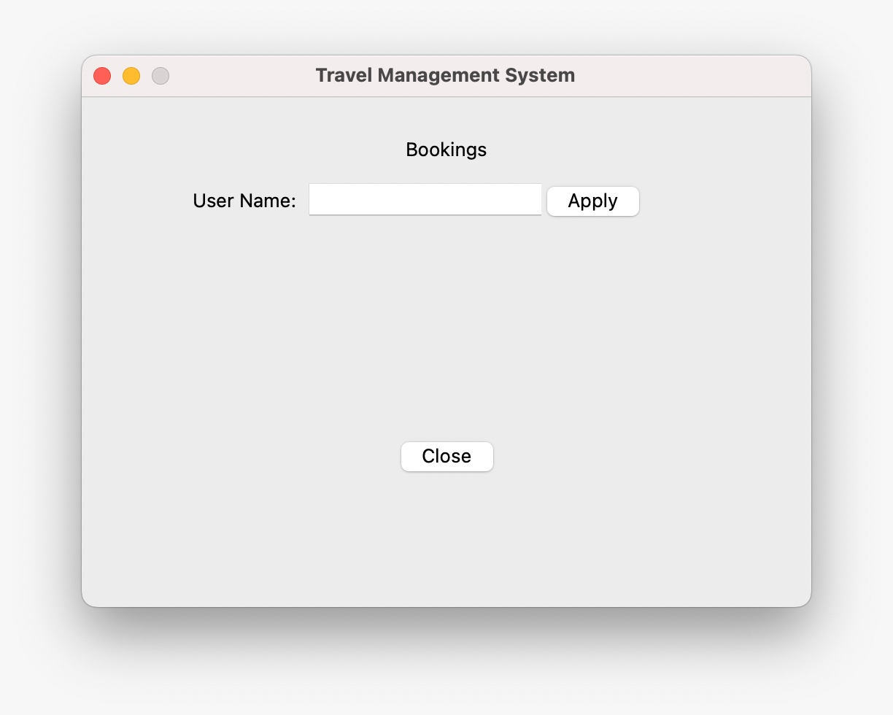
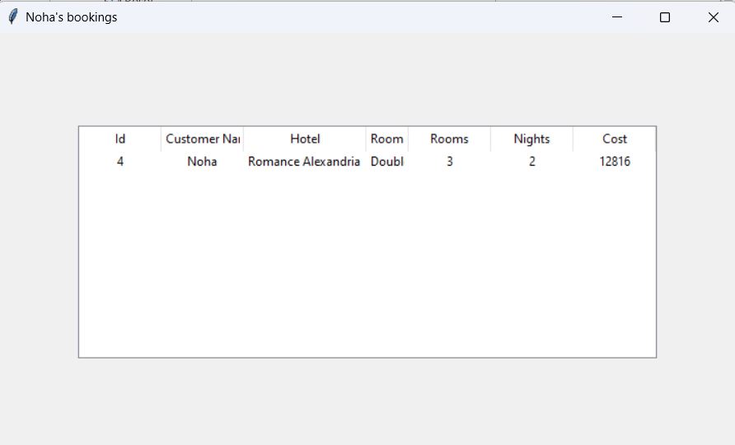
Get Booking
It only requires the user's username to retrieve bookings.
Upon inputting the username, the system will display the corresponding user data along with their bookings.

Slide 13
Attraction management

Slide 14
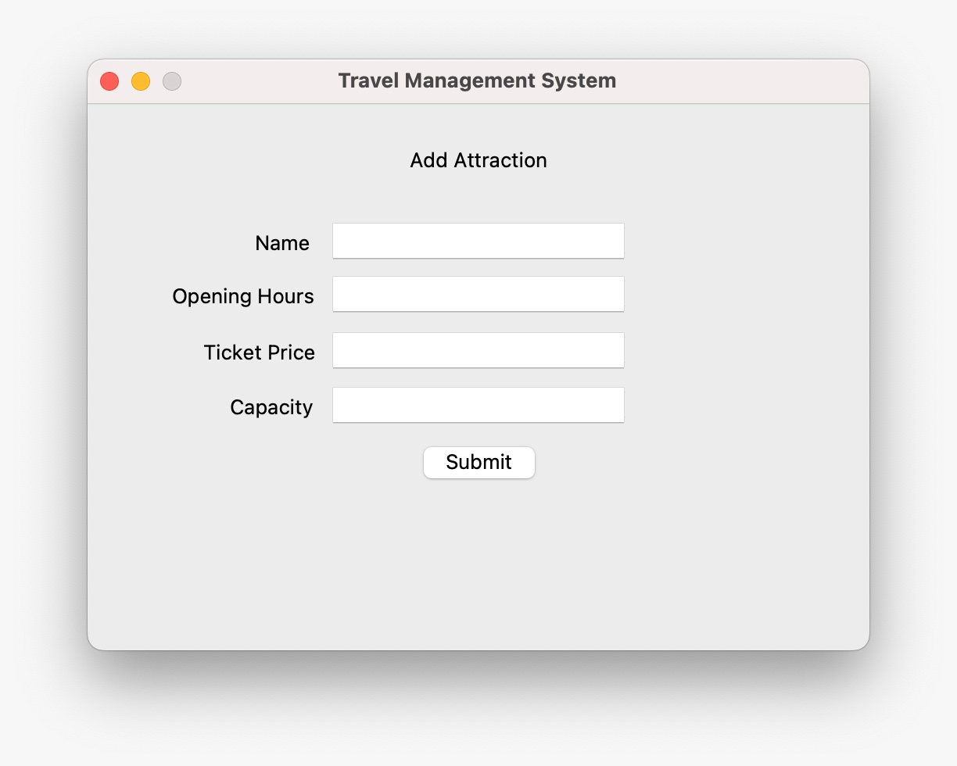
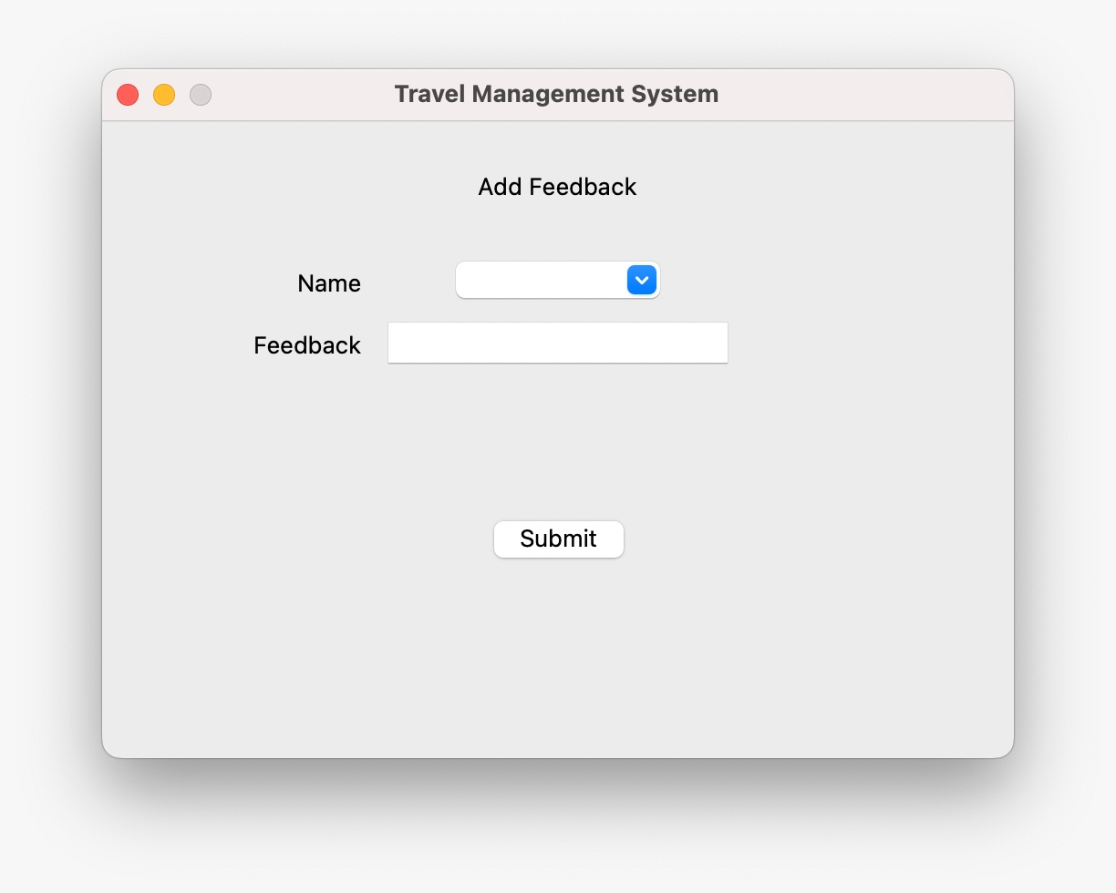
Attraction Management Add Attraction and Feedback:
The user fills in the necessary details when adding an attraction.
Additionally, the user provides feedback for the selected attraction.

Slide 15
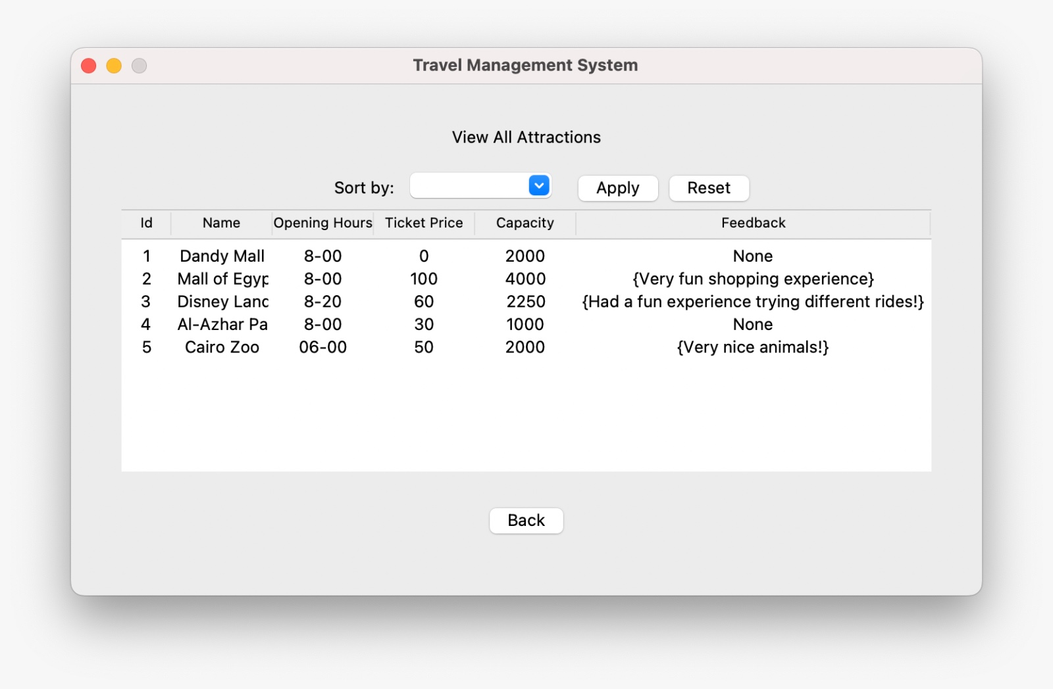
Attraction Management Get Attraction and Feedback:
As demonstrated, it is possible to showcase all attractions, encompassing the feedback that has been provided

Slide 16
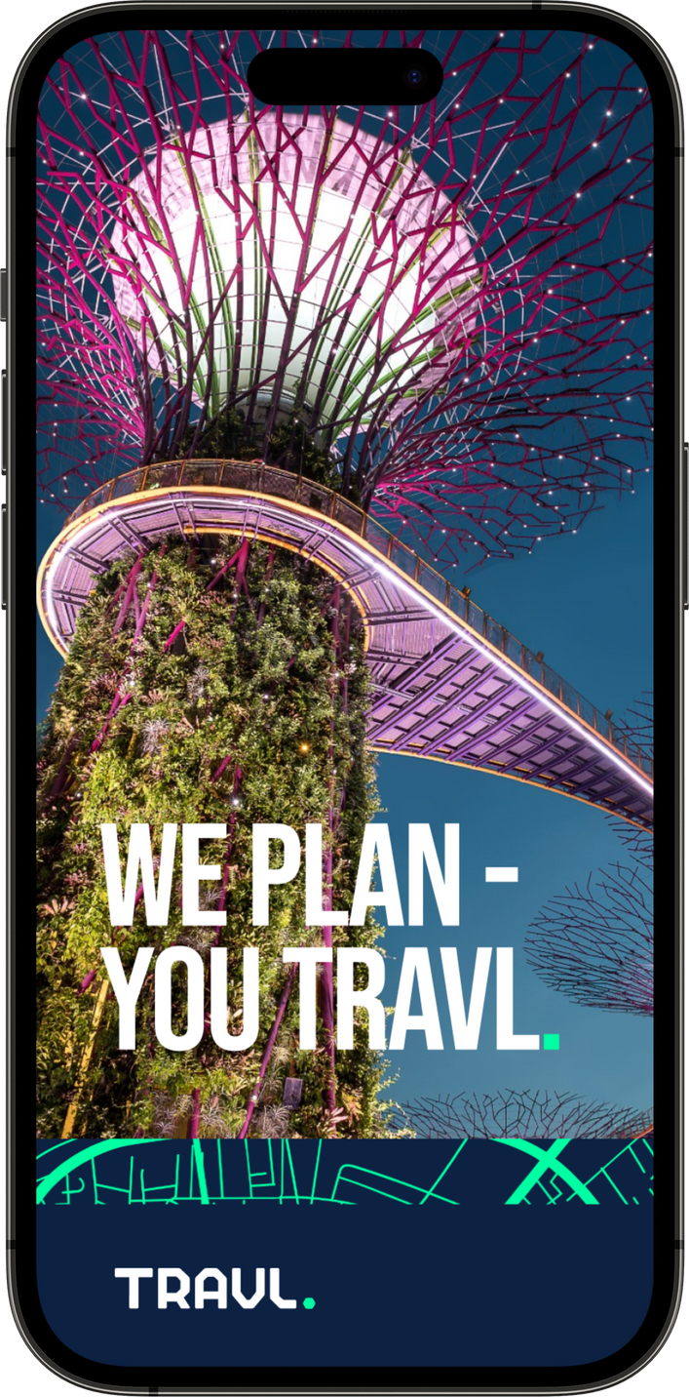
•
Thank You For Listening !!!

